Slide 1
Identifying NREM Sleep Stages in Consumer Wearables
Daniel J. Fasciano, Matthew S. Shimko, Tran N. Ton, An T. Butchers
Georgia institute of technology

Slide 2
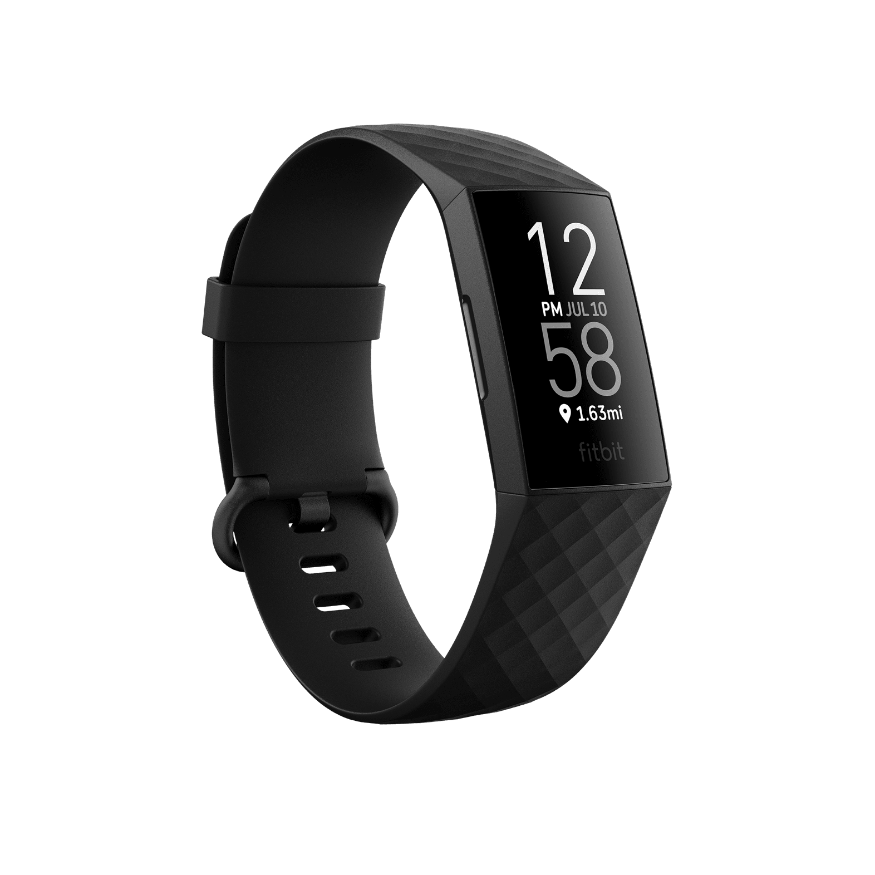
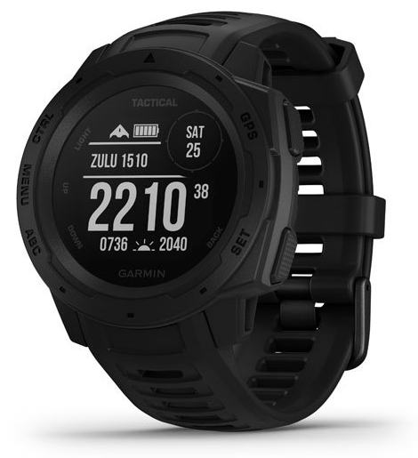
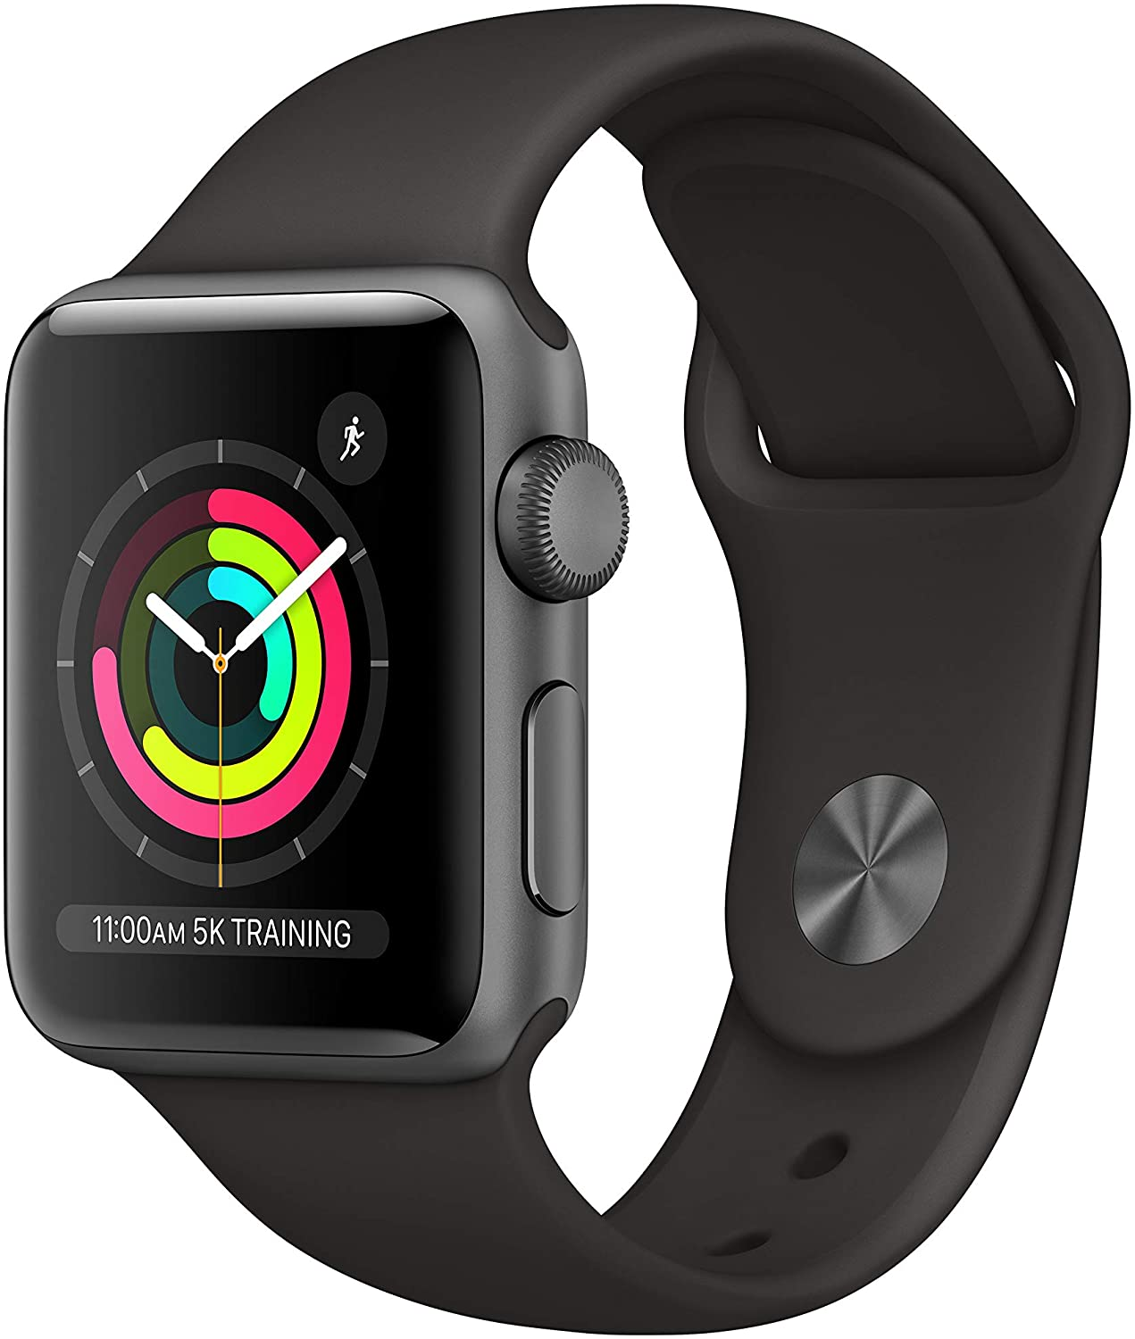
Motivation
Sleep is in important part of life.
Sleep quality strongly linked to brain health.
Greater availability in access to sleep data via wearable devices.
Being able to utilize these devices can help provide earlier identification and prevention of brain disease.

Slide 3
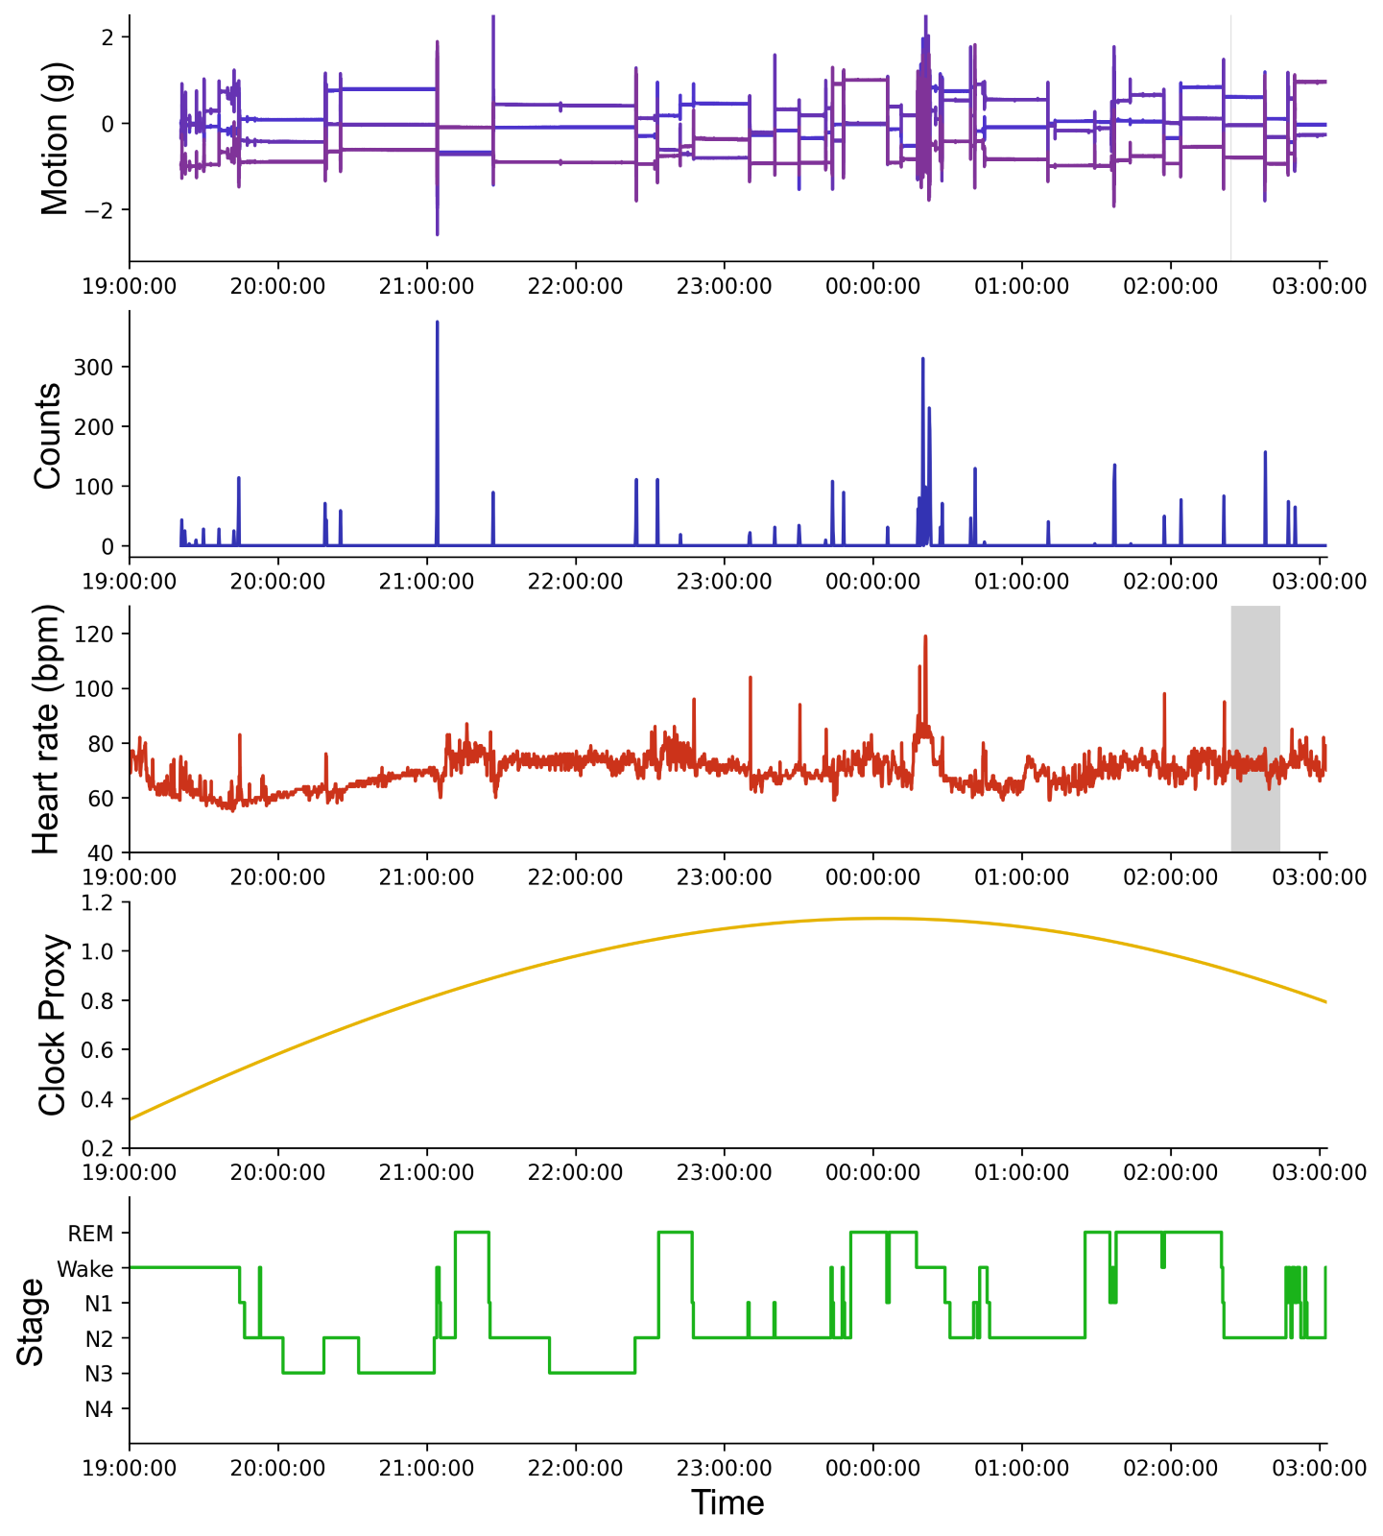
Sleep Stages
Two basic sleep stages: Rapid Eye Movement (REM) and non-REM sleep (N1, N2, N3)
Example of a chart showing sleep stages over the course of the night for one subject

Slide 4
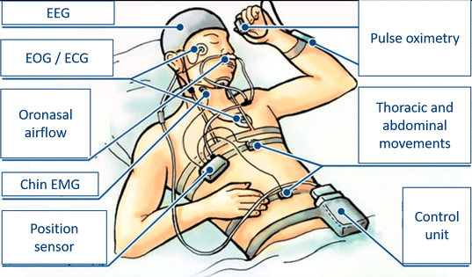
Traditional Methods
Polysomnogram (PSG)
Complicated and expensive.
Potential for inaccurate data due to uncomfortable sleep with all the attached sensors.
New wearable electroencephalography (EEG) devices can provide similar data.
Professionals would then review the data and categorize each sleep stage.

Slide 5
Wearable Limitations
Without using certain algorithms, wearables cannot determine sleep stage.
However, using machine learning classification, we can train models to determine the sleep stages and use this data in a similar way to how the PSG data would be used.

Slide 6
Past Studies
Biswal et al: Trained a deep recurrent neural network (RNN) using expert defined features to train
Tsinalis et al: Used a convolutional neural network (CNN) with feature extraction to score based on EEG data without needing expert domain knowledge
Hassan and Subasi: Used Bootstrap Aggregating to learn EEG annotations
Zhao et al: used radio technologies to get data, and used CNN and RNN to learn sleep stages

Slide 7
Walch et al
Motion and heart rate from a wrist-worn wearable and labeled sleep from polysomnography
This was a study using wearable data to train models with data from Apple Watch readings
Used to create to categorization models: Wake vs Sleep and Wake vs NREM vs REM
Models were trained on individual study data, and then ran on Multi-Ethnic Study of Atherosclerosis (MESA) data as well
Results:
93% True sleep epochs scored correctly
60% True wake epochs scored correctly
72% NREM/REM Differentiation epochs scored correctly
53% - 40% accuracy when used on MESA data

Slide 8
Our Proposal
Expand on Walch’s experimentation to improve the classification ability by developing models capable of Wake/N1/N2/N3/REM differentiation and Wake/N1+N2/N3/REM differentiation
We will use the same data source Walch has used, as well as repurposing much of her feature generation code, with the main changes being to the model training and validation portions of the code

Slide 9
Four Feature Sources
Originally planned to do ETL in AWS environment, however due to the size of the data and scope of the project, we ended up using local environments which were more appropriate for our code base
Utilized Python, with Pandas, Scikit and SciPy libraries
Features:
Motion, Heart Rate, Circadian / Clock, Polysomnography (PSG)

Slide 10
Motion
Raw data comes in form of x, y and z directions in g
Interpolation used to create a record for every second
te Lindert’s algorithm to convert acceleration data to activity counts
Gaussian filter used to smooth the data

Slide 11
Heart Rate
Raw data is in beats per minute (bpm) and is sampled every few seconds.
Data is interpolated to have one record per second.
Gaussian filter is applied to smooth the data.
Data is then normalized between all subjects.
Feature used is the standard deviation of the heart rate values.

Slide 12
Clock / Circadian
Clock:
Used to consider changes in subject’s circadian rhythms over the course of the night.
Used a Cosine curve which started at the beginning of the subject’s sleep period and ended at the end.
Circadian:
Typically, light sensors are used to determine the subject’s circadian clock, but these are not available on an apple watch.
Substituted light with step count and used thresholds to determine how many steps warranted a subject being awake and correlated them to different times of day.

Slide 13
Polysomnography (PSG)
This is used as the label for the data, and uses integers to refer to each sleep stage

Slide 14
Training
For training, Monte Carlo cross validation is used.
The data is split randomly ten times into a 70/30 training/testing ratio of subjects.
Our goal was to initially recreate Walch’s experiments, and then train our own models with for our different classification groupings.
Initially, we used similar models to Walch, and analyzed performance of a 5-stage classifier using Logistic Regression, Random Forest and k-Nearest Neighbors.
ROC Curves were used to analyze the performance of each classification.

Slide 15
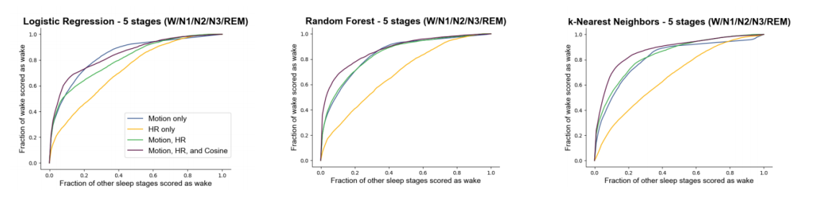
Initial Results: Wake
Overall, each model does a pretty decent job of determining if a subject is awake, however the best performer was k-Nearest Neighbors, which reached around a 90% accuracy level

Slide 16
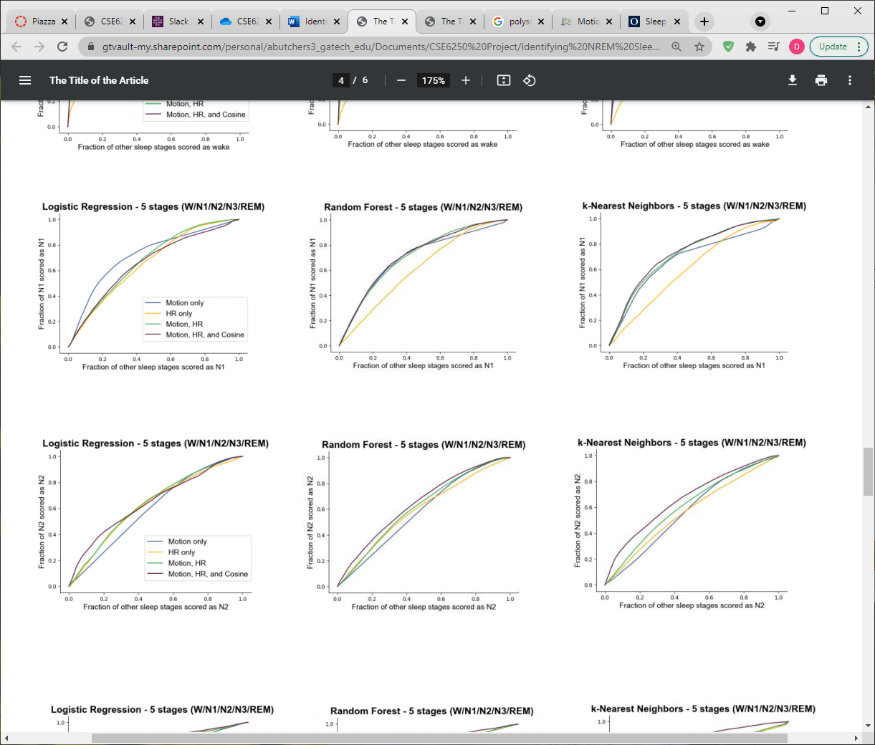
Initial Results: N1
Performance for classifying N1 was less performant, with the best performing being Random Forest being around 80% accurate
Interestingly, Logistic regression with only activity counts performed as well as all the features with Random Forest

Slide 17
Initial Results: N2
Accuracy is further declining in N2, with only about 60% accuracy in classifying N2 across the models
None of the models particularly stand out in performance, although kNN seems to be the best performer

Slide 18
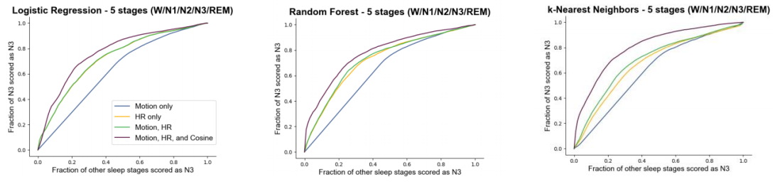
Initial Results: N3
Categorization of N3 shows a decent performance hike, with KNN reaching 80% accuracy, however all models performed well.
This seems indicative that N3 must be more distinctive in how the subjects’ data is represented, especially when compared to N1 and N2.

Slide 19
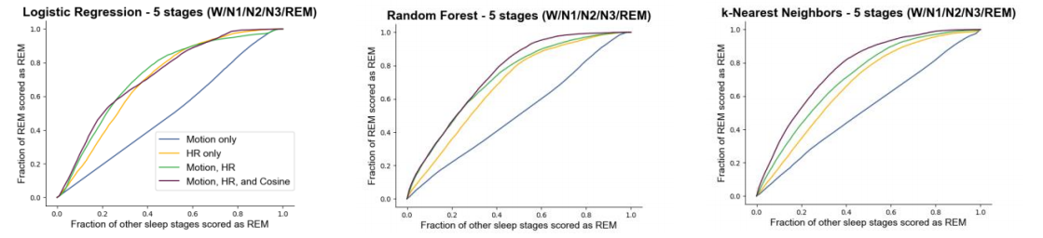
Initial Results: REM
REM classification is also similar in terms of performance, and gets similar accuracy scores to N3 classification.
kNN seems to perform the best here as well, reaching around 80% accuracy.

Slide 20
Initial Conclusions
Overall, our model performed well, although it was weakest when categorizing N1 and N2 sleep stages.
We continued to experiment with different types of models as well as parameters on our existing chosen models in order to determine what the ideal model would, as well as to improve upon our baseline performance.

Slide 21
Initial Issues
We ran into a slow process in requesting the MESA data and did not have access to it until recently.
While still working through the Walch’s codebase, we ran into some bottlenecks when running on our local machine that took time to troubleshoot.
Originally, we planned to rewrite the entire ETL pipeline, however through investigation we decided it made more sense to continue with the initial codebase so we could focus on the model training aspect.
Running a Neural Net locally proved to be very difficult on our hardware, so we were not able to fully utilize it during our initial testing.

Slide 22
Final Training
We did significant experimentation for our final iteration with this data.
Did additional hyperparameterization on previous ML algorithms.
Included additional ML Algorithms: AdaBoost and Neural Network.
Experimented with 4 Stage Classifier: Wake/N1+N2/N3/REM.

Slide 23
Hyperparameterization
We tried to improve performance on the algorithms we used previously: Logistic Regression, Random Forest, k-Nearest Neighbors.
We were unable to get any significant improvements in performance over the prior results.

Slide 24
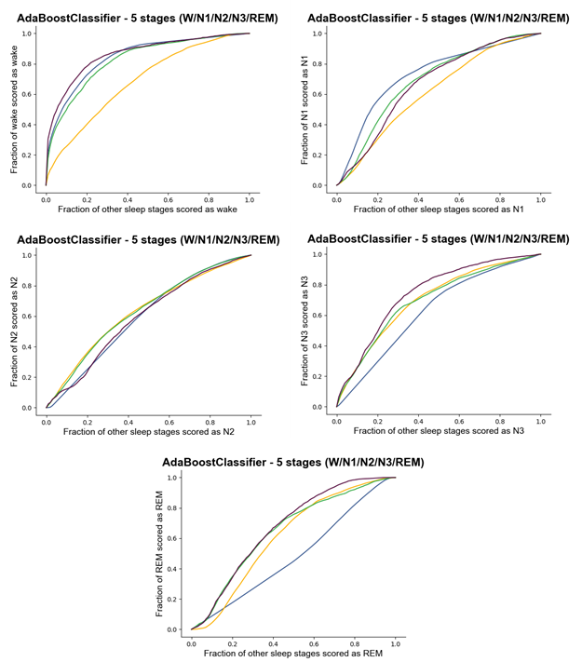
AdaBoost
We were able to incorporate this new model into the existing codebase.
It performs well, hitting between 60-80% accuracy on each stage.
Still struggles with N1 and N2, which was seen in the other algorithms.
Overall, performance with this algorithm, while decent, was still not as good as Random Forest and k-NN.

Slide 25
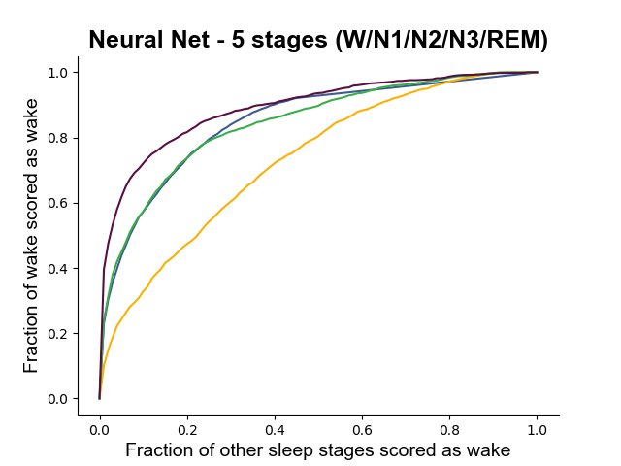
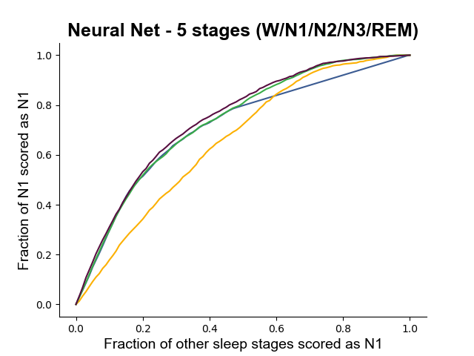
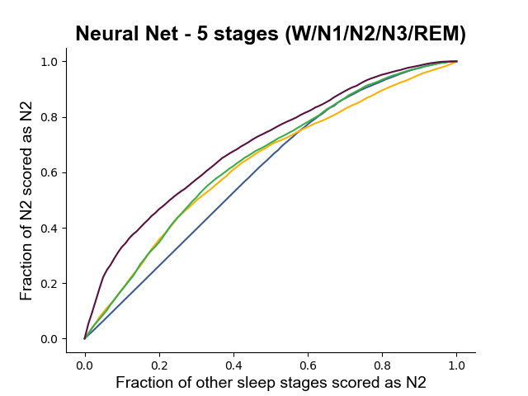
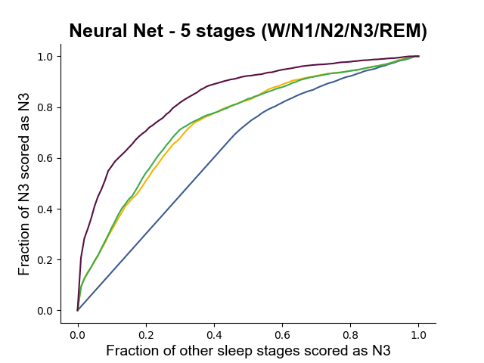
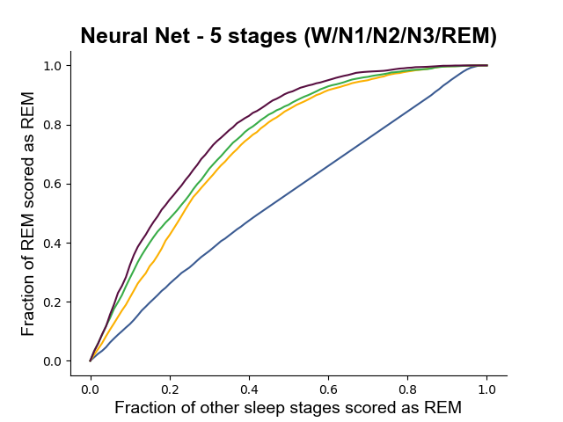
Neural Net
Initially, we had problem with Neural Net taking too long to run. However, we modified the code to reduce iterations and was able get results for Neural Net in an acceptable amount of time.
It still took 10 times longer to run than other classifiers while giving equivalent results to k-NN.

Slide 26
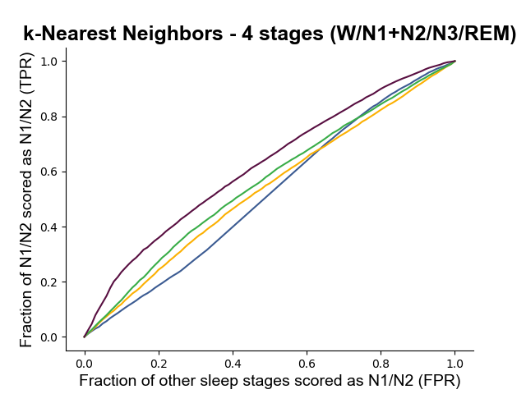
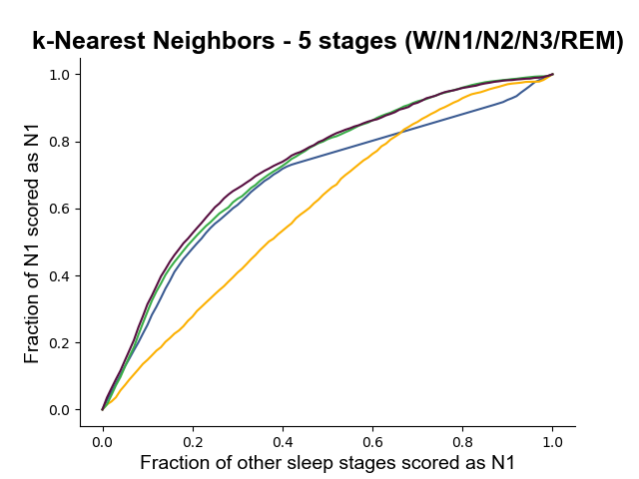
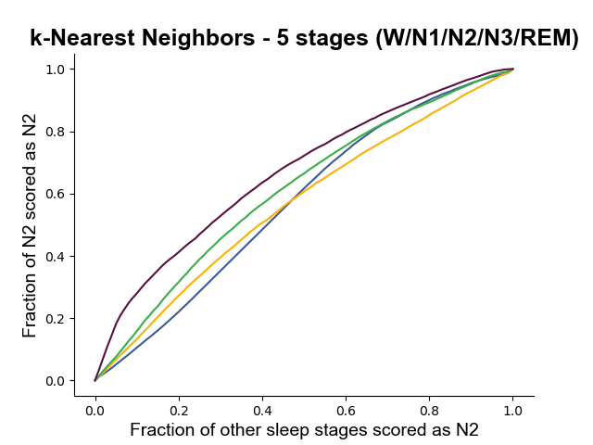
Four Stage Classifier
We made adjustment to the codebase to accommodate a four-stage classifier.
N1 and N2 stages were combined, as they are both considered light sleep.
Performance for classifying these two stages was worse than the five-stage classifier, so most effort was focused on the five-stage classifier.
vs
N1 + N2
N1
N2

Slide 27
N2 Classification
As this stage consistently demonstrated the worst performance, we investigated it more deeply.
Motion and heart rate tend to be very flat during this stage, meaning there is limited activity and a slow heart rate.
There are many more samples of N2 than other stages, which creates a class imbalance problem.
We believe this contributes to the high false positive rate.

Slide 28
Additional Features
Based on research we discovered that body temperature tends to drop during the N2 stage, which means that if we had access to body temperature as an additional feature it may add some value.
Another helpful feature would be audio to detect snoring.

Slide 29
Improvements
Overall, we were able to make improvements over Walch's work.
Our models showed good performance for N3 stage classification.
The N3 sleep stage is known as deep/restorative sleep, so being able to identify it is very important for improving future sleep studies.

Slide 30
Conclusions
Sleep continues to be an important aspect of well-being, so further study on how to understand our sleep habits in more efficient ways is very valuable.
We were able to get good classification results on a five-stage classification model, however there is still room for improvement.

